Slide 1

Data Science For Business
January 2025
Module 4 – Regularization

Slide 2
Quiz time!

Slide 3
Quiz discussion!

Slide 4
Q1
0
1
2
3

Slide 5
Q1
0
1
2
3

Slide 6
Agenda
Week 1
Module 1 (Thursday): Intro to data science + Python for DS
Module 2 (Friday): Intro to supervised learning
Week 2
Module 3 (Monday): Fitting models, generalization
Module 4 (Tuesday): Regularization
Module 5 (Wednesday): Evaluation (ROC, cost visualization)
Module 6 (Thursday): Modeling text data
Week 3
Module 7 (Monday): Neural networks, GenAI
Module 8 (Tuesday): Guest lecture(s)
Module 9 (Wednesday): Causal inference, AB testing, wrap up
Final Exam (Thursday)

Slide 7
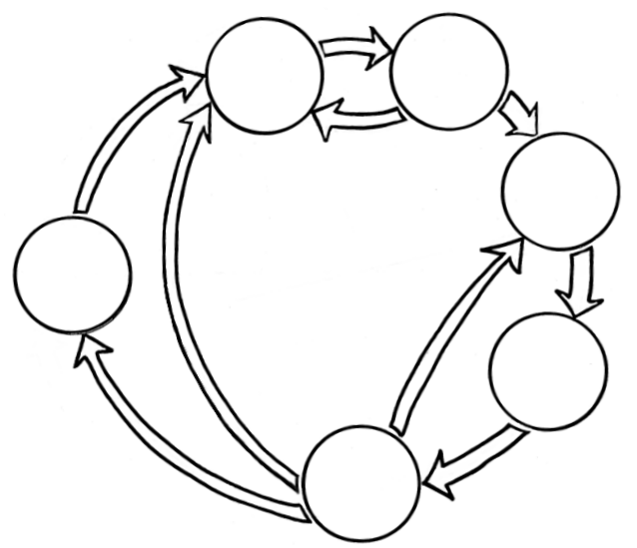
Where we are
Business Understanding
Data Understanding
Data Preparation
Data Science
Process
Deployment
Modeling
Evaluation

Slide 8
Where we are
Business Understanding
Data Understanding
Last class
Data Preparation
Data Science
Process
Deployment
Modeling
Evaluation

Slide 9

Building Your Toolbox
Business Understanding
Data Understanding
Last class
Types of Tasks and Models
Data Preparation
Supervised Learning
Data Science
Process
Classification / Probability Estimation
Deployment
Decision tree
Linear separator/ logistic regression
Modeling
Regression
Linear/polynomial regression
Regression tree
Evaluation

Slide 10

Building Your Toolbox
Business Understanding
Data Understanding
Last class
Evaluation Techniques/Considerations
Data Preparation
Data Science
Process
Overfitting (the training data) → worse generalization (on unseen data)
K-fold cross-validation is a way to evaluate generalization
Deployment
Modeling
Evaluation

Slide 11



Building Your Toolbox
Business Understanding
Data Understanding
Today
Data Preparation
Data Science
Process
Deployment
Modeling
Evaluation

Slide 12
Building Your Toolbox
Today
How to avoid overfitting? → Regularization
L1, L2
Data preparation to perform regularization well
Normalization
Standardization
How to avoid overfitting? → Hyper-parameter tuning
How to assess whether to get more data? → Learning curves

Slide 13
Notebook time!

